Slide 1
Apprenticeships – England & Scotland
Changes for 2021 and beyond……
Dr Iain Baillie, Chief of Resource Strategy, Rolls-Royce & President, BINDT
March 2021
This information is provided by Rolls-Royce in good faith based upon the latest information available to it; no warranty or representation is given; no contractual or other binding commitment is implied.
Non-confidential
© 2020 Rolls-Royce
Not Subject to Export

Slide 2
Contents
Introduction
The problem with NDT recruitment
Government Apprenticeships comparison between England and Scotland
Engineering Technician Standard (Robert Bruce, Enginuity)
Degree (Lewis Philip, Rolls-Royce)
Non-confidential
© 2020 Rolls-Royce
Not Subject to Export

Slide 3
01
Introduction

Slide 4
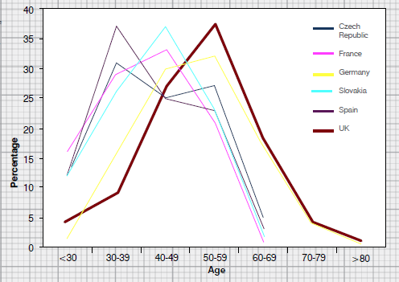
Problem Statement
01
REF: KTN Report “A Landscape for the future of NDT in the UK Economy”
Our UK ~450 NDT suppliers to Rolls-Royce are in the same boat…………
Non-confidential
© 2020 Rolls-Royce
Not Subject to Export

Slide 5
02
Solution

Slide 6
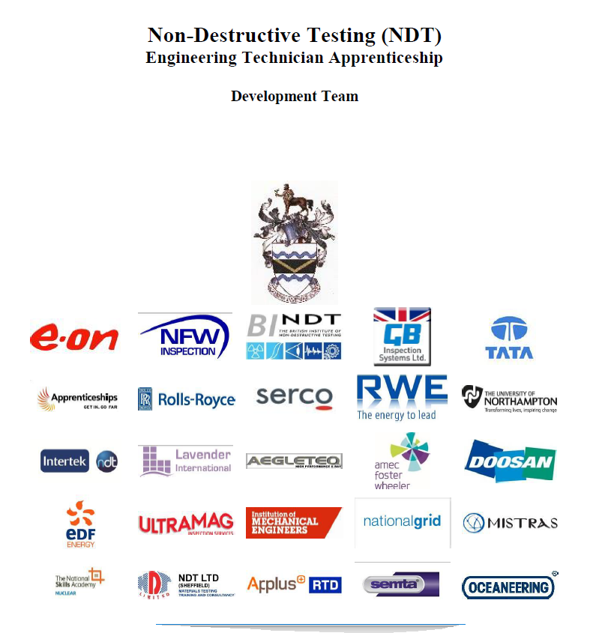
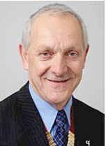
02
An opportunity for NDT
BINDT became aware the Government were looking at new “Trailblazer” apprenticeships.
BINDT formed an employer’s group to help draft new Government standards.
Rolls-Royce took on the role
of “lead employer.”
Project Managed BINDT’s
& Roger Lyon.
Non-confidential
© 2020 Rolls-Royce
Not Subject to Export
Non-confidential
© 2018 Rolls-Royce
Not Subject to Export Control

Slide 7
02
What the employer group wanted
NDT qualifications (EN4179 and/or PCN ISO:9712).
Flexibility to chose what (or even if) we wanted when it came to college & university courses.
To ensure apprentices were ethical and had the right work behaviours; communication, project delivery, integrity,
To be as inclusive as possible, so small and large employers could use the scheme. To ensure equipment manufacturers could use the scheme.
To ensure we gained the maximum possible funding
To cover shop floor inspectors at NDT Level 2 and promoting them to the next NDT Level 3.
Non-confidential
© 2020 Rolls-Royce
Not Subject to Export
Non-confidential
© 2018 Rolls-Royce
Not Subject to Export Control

Slide 8
 |  | Apprenticeship Certificate Requirements (Government Standard & Mandatory) |  |  | Engineering Council Requirements, administered by the British Institute of NDT (BINDT)
Country | Standard | Max. Funding | Approx. Time Taken | Qualifications (Mandatory) | No. of years engineering experience | BINDT membership and Engineering Registration suitability
England | Operator STO358 | £12K | 1.5 years | 1 NDT Level 2 | EngTech – 3 years’ experience | AMInstNDT (with 3 years experience)
 | Technician STO2888 | £18K | 3 years | 3 NDT Level 2s | IEng – 5 years’ experience | AMInstNDT (with 3 years experience)
 | Engineer STO369 | £27k | 4 years | >= 1 NDT Level 3 BEng or BSc NDT Degree | Interim IEng after 4 years experience with 1 year wait for full registration. | MInstNDT (with 5 years experience)
Scotland | Technician (Draft) |  | 3 years | NDT Level 2s + college qualification (draft) |  | AMInstNDT (with 3 years experience)
 | Graduate Apprenticeship Engineering | University fees = £0 | 4 years | BEng (Hons) Engineering: Design and Manufacture | IEng – 5 years’ experience | MInstNDT (with 5 years experience)
ibaillie2017

Slide 9
03
Apprentice Numbers
Current apprentices | Qualifications | Numbers
Operator | 1 Level 2 | 27
Technican | 3 Level 2s | 96
Engineer | Level 3s + Degree | 28
Apprentices who have now passed EPAs | Qualifications | Numbers
Operator | 1 Level 2 | 2
Technician | 3 Level 2s | 12
Engineer/Graduate | Level 3s + Degree | 1
Non-confidential
© 2020 Rolls-Royce
Not Subject to Export

Slide 10
04
Conclusion
During the apprenticeship, they start to become VERY useful after a year or so.
Replace retirees.
Excellent work ethic and enthusiasm
Prize winning (e.g. top of year 1st class degrees, university prizes, BINDT prizes, IOM³ awards etc)
Right thing to do
Non-confidential
© 2020 Rolls-Royce
Not Subject to Export

